Slide 1
BASIC CONCEPTS IN R PROGRAMMING

Slide 2
INTRODUCTION TO R PROGRAMMING
WHAT IS R ?
WHAT ARE FEATURES OF R ?
WHERE I GET R-SOFTWARE ?
HOW TO INSTALL R ?
HOW TO INSTALL R STUDIO?
WHAT ARE THE REFERENCE BOOKS FOR LEARNING R ?

Slide 3
WHAT IS AN R - SOFTWARE ?
THE ROOT OF R IS THE S LANGUAGE, IT WAS DEVELOPED BY JOHN CHAMBERS AT BELL LABORATORIES STARTED IN 1960. THE S IS NOT FREE.
R STARTED IN THE EARLY 1990’S AS A PROJECT BY ROSS IHAKA AND ROBERT GENTLEMAN AT THE UNIVERSITY OF AUCKLAND, NEW ZEALAND, INTENDED TO PROVIDE A STATISTICAL ENVIRONMENT IN THEIR TEACHING LAB.

Slide 4
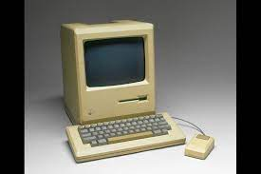


THE LAB HAD MACINTOSH COMPUTERS, FOR WHICH NO SUITABLE COMMERCIAL ENVIRONMENT WAS AVAILABLE.
THE DEVELOPMENT OF R- PACKAGE HAS BEEN PHENOMENAL.
IT IS HEAVILY INFLUENCED BY THE OPEN SOURCE IDEA.
  “We have named our language R - in part to acknowledge the influence of S and in part to celebrate our own efforts.”
-- R. Ihaka
R. Gentleman
Ross Ihaka
Robert Gentleman

Slide 5
INTRODUCTION
THE CORE OF R IS AN INTERPRETED COMPUTER LANGUAGE.
R ALLOWS BRANCHING AND LOOPING AS WELL AS MODULAR PROGRAMMING USING FUNCTIONS.
MOST OF THE USER-VISIBLE FUNCTIONS IN R ARE WRITTEN IN R, CALLING UPON A SMALLER SET OF INTERNAL PRIMITIVES.
IT IS POSSIBLE FOR THE USER TO INTERFACE TO PROCEDURES WRITTEN IN C, C++ OR FORTRAN LANGUAGES FOR EFFICIENCY, AND ALSO TO WRITE ADDITIONAL PRIMITIVES.

Slide 6
ABOUT R- SOFTWARE ?
R IS A FREE & OPEN SOURCE SOFTWARE.
R IS INTERACTIVE AND HAS GOOD INTERFACE
THE BASIC PACKAGE IS ABOUT 29 MB IN SIZE.
THE CORE OF R IS AN INTERPRETED COMPUTER LANGUAGE.
LEARNING TO USE THE PACKAGE IS SIMPLE.
R- GRAPHICS COMPONENT IS POWERFUL STATISTICAL GRAPHICS AND FLEXIBLE.
R HAS GOOD ENVIRONMENT FOR DATA MANIPULATION AND CALCULATION AND GRAPHICAL DISPLAY.
MOST R-PACKAGES DEAL WITH STATISTICS AND DATA ANALYSIS.
IT IS COMPATIBLE FOR PROCEDURES WRITTEN IN C, C++, FORTRAN AND OTHER LANGUAGES.

Slide 7
CONTD...
R SUPPORTS A SUITE OF OPERATORS FOR CALCULATIONS ON ARRAYS, IN PARTICULAR MATRICES,
A WELL DEVELOPED PROGRAMMING LANGUAGE WHICH INCLUDES CONDITIONALS, LOOPS, USER DEFINED RECURSIVE FUNCTIONS AND INPUT AND OUTPUT FACILITIES.
R IS A FLEXIBLE DATA EXCHANGE MECHANISM ACCESSING RELATIONAL DATABASES ODBC, POSTGRESQL, MYSQL ETC.
R IS A MOSAIC OF PROCEDURE-BASE AND OBJECT-ORIENTED PROGRAMMING

Slide 8
WHAT R DOES AND DOES NOT
R do’s
Data handling and storage: numeric, textual
It supports data visualization hash tables and regular expressions
High-level data analytic and supports many statistical functions
It supports object oriented, classes,
Programming language: loops, branching, subroutines
R do not
It is not a database, but connects to DBMS
It has no Graphical User Interfaces, but connects to Java, TclTk
Language interpreter can be very slow, but allows to call own C / C++ code
No spreadsheet view of data, but connects to databases Excel / Ms-office
no professional / commercial support

Slide 9
SOURCE FOR R ?
THE OFFICIAL HOME PAGE OF THE R PROJECT IS
HTTP://WWW.CRAN.R-PROJECT.ORG
NOTE: ALL RESOURCES ARE AVAILABLE. THE R SYSTEM ITSELF, A COLLECTION OF ADD-ON PACKAGES, MANUALS, DOCUMENTATIONS, AND MORE.

Slide 10
HOW TO INSTALL R
SEARCH FOR THE KEY WORD, ‘R’ ON SEARCH ENGINE OF GOOGLE.
SELECT THE WEB PAGE HTTP://WWW.CRAN.R-PROJECT.ORG : ‘THE R-PROJECT FOR STATISTICAL COMPUTING’ AND CLICK. THE OFFICIAL WEB PAGE OF R POPS UP.
CLICK ON ‘DOWNLOAD CRAN’. CRAN MIRRORS PAGE POPS UP. TO INSTALL R, CLICK ON ‘DOWNLOAD R IN WINDOWS’.
CLICK ON ‘BASE’ TO INSTALL ONLY THE ‘BASE’ PART OF R.
CLICK ON ‘R.2.X.X-WIN32EXE’
FOLLOW THE DIRECTIONS. CLICK ALWAYS ‘NEXT’. CREATE SHORT CUT ON DESKTOP.

Slide 11
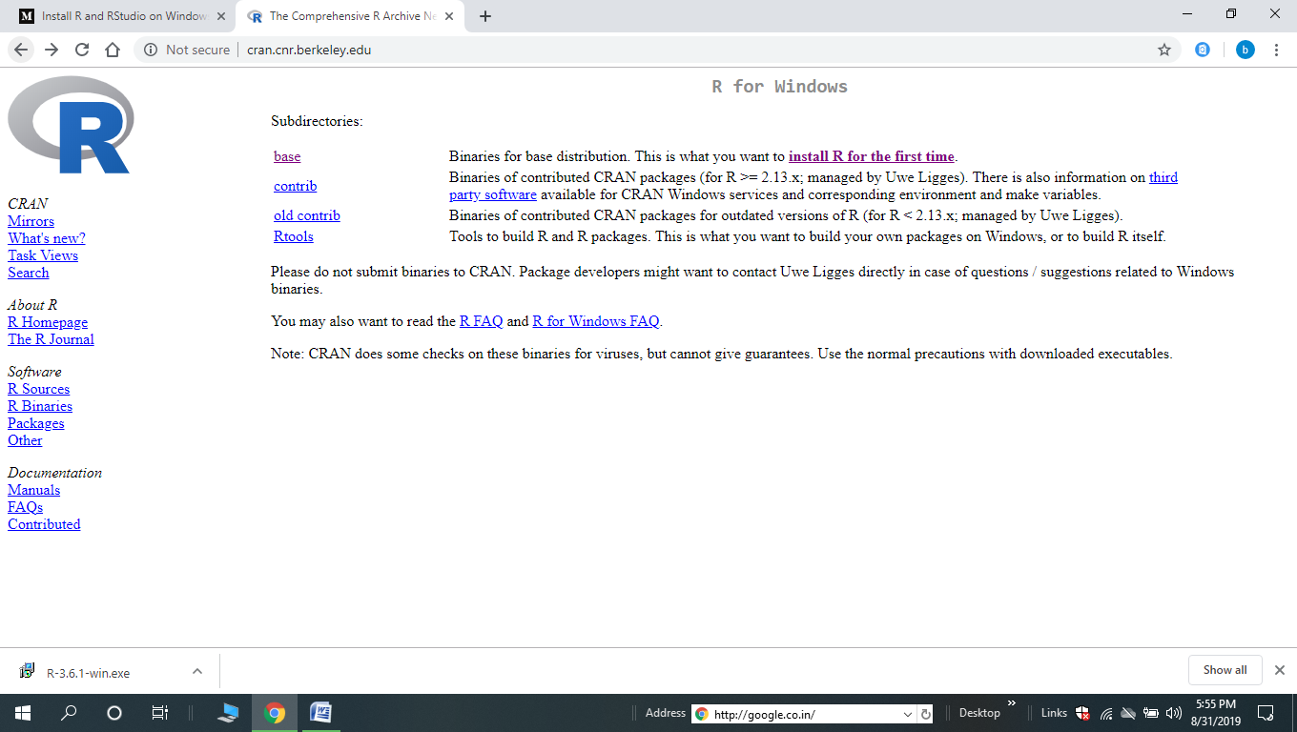

Slide 12
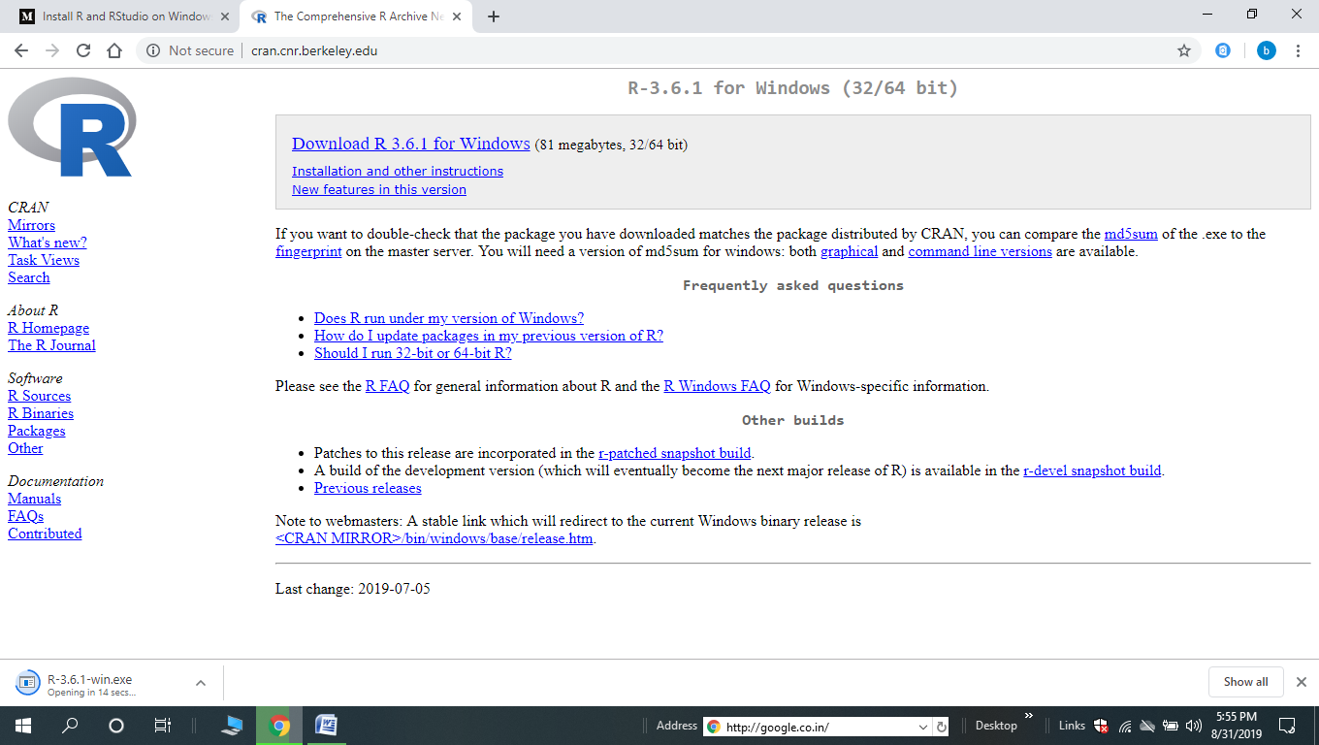

Slide 13
OPEN R
TO OPEN R SOFTWARE BY DOUBLE CLICK ON THE ICON.
THE GRAPHICAL USER INTERFACE IS

Slide 14
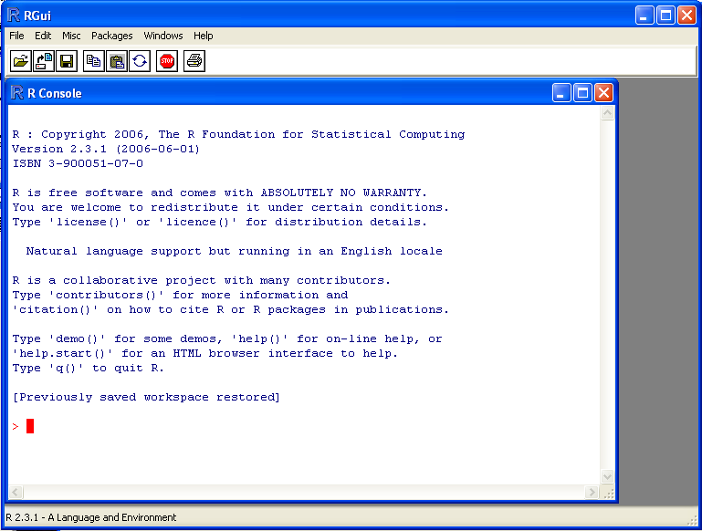
R WINDOW

Slide 15
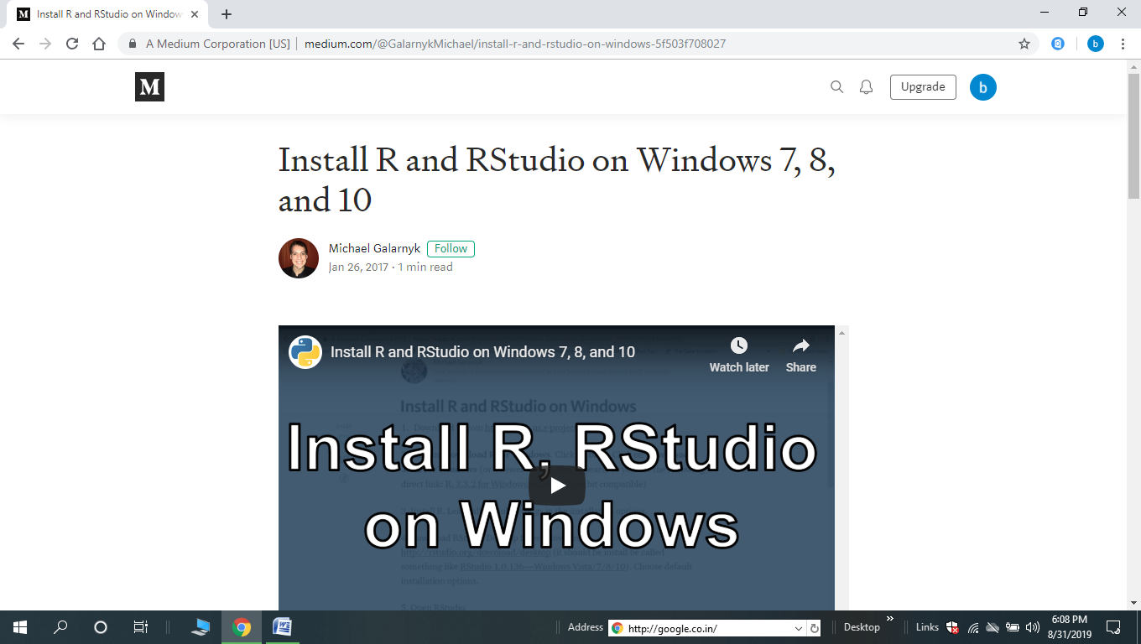

Slide 16
COMMAND PROMPT
THE MOST CONVENIENT WAY TO USE R IS AT A GRAPHICS WORKSTATION RUNNING A WINDOWING SYSTEM.
WHEN R PROGRAM IS USED IT ISSUES A DEFAULT PROMPT ‘>’ WHEN IT EXPECTS INPUT COMMANDS. (IT ISSUES $ SHELL PROMPT ON UNIX)

Slide 17
OPEN, SAVE AND QUIT IN R
    ENTER COMMANDS AT THE COMMAND PROMPT ( > ) . PRESS ENTER KEY TO RUN THE COMMAND.
    TO QUIT FROM R , USE > Q()
    TO EXPLICITLY SAVE THE WORKSPACE IMAGE.
    GO TO THE `FILE‘ MENU AND THEN SELECT `SAVE WORKSPACE...', OR USE THE SAVE.IMAGE FUNCTION.
        SAVE.IMAGE() : TO SAVE IN THE CURRENT WORKING DIRECTORY
        SAVE.IMAGE("C:\\PROGRAM FILES\\R\\R-2.5.0\\BIN\\.RDATA") : WITH A SPECIFIC FILE AND LOCATION
        GETWD() : TO KNOW THE CURRENT WORKING DIRECTORY
  LS() :TO LIST OBJECTS IN THE CURRENT WORKSPACE
  SETWD(MY_DIRECTORY) : CHANGE TO MY_DIRECTORY

Slide 18
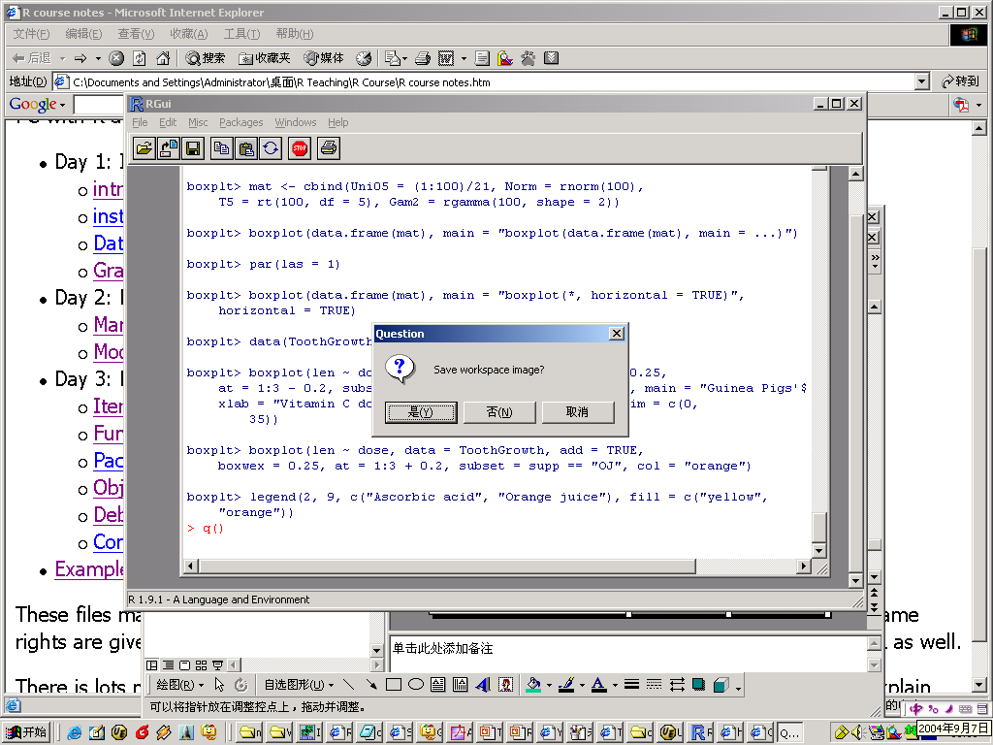
QUIT R
COMMAND : >Q() TERMINATE AN R SESSION

Slide 19
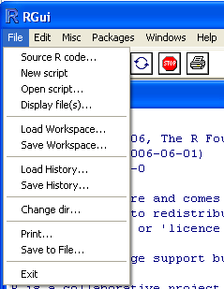
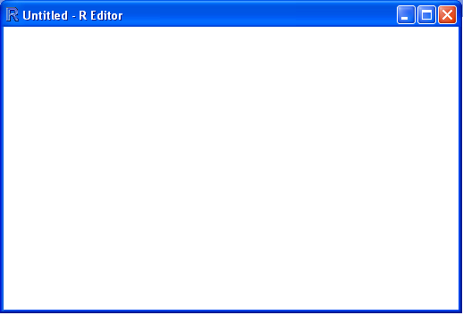
R SCRIPT WINDOW
SELECT FILE THEN SELECT NEW SCRIPT IT OPENS A SCRIPT WINDOW WITH UNTITLED R EDITOR LIKE AS FOLLOWS

Slide 20
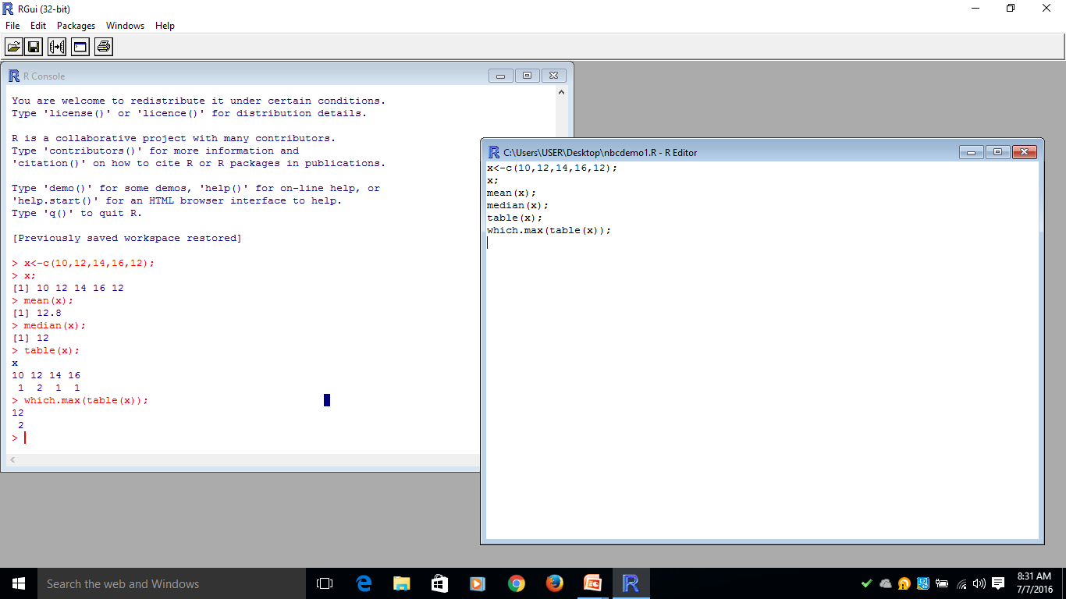
HOW TO RUN THE R CODE AND HOW SAVE THE FILES
TYPE R CODE ON R EDITOR THEN HIGHLIGHT THE LINES TO BE EXECUTED ON THE R EDITOR THEN SELECT EDIT IN MAIN MENU, SELECT RUN LINES.
TO SAVE THE R CODE GO TO FILE SELECT SAVE AS AND GIVE THE NAME FOR FILE TO BE SAVED.

Slide 21
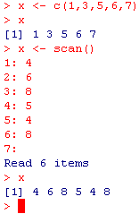
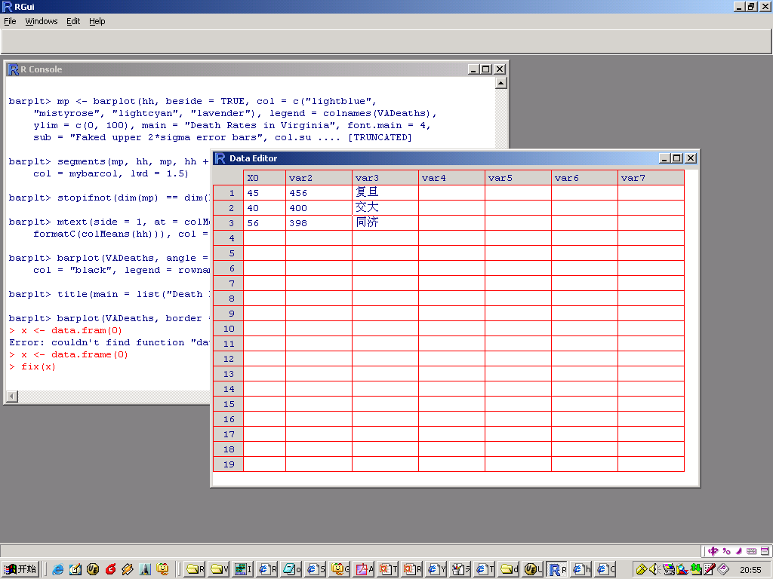
DATA INPUT
FROM THE KEYBOARD ONE BY ONE
  C( ); SCAN( )
FROM THE FILE
  READ.TABLE(); READ.CSV(); READ.CSV2();
  READ.DTA(); READ.SPSS(); …
BY A SPREADSHEET
  DATA.ENTRY()
  EDIT()
  FIX()
  ……

Slide 22
R HELP
TYPE THE PACKAGE FOR SOME DEMOS: 'DEMO()'
TYPE THE TOPIC/COMMAND FOR ON-LINE HELP: ' HELP() '
TYPE THE TOPIC/COMMAND FOR AN HTML BROWSER INTERFACE TO HELP: 'HELP.SEARCH()'
TYPE TO QUIT R: 'Q()'

Slide 23
R WORKSPACE
  OBJECTS THAT YOU CREATE DURING AN R SESSION ARE HOLD IN MEMORY, THE COLLECTION OF OBJECTS THAT YOU CURRENTLY HAVE IS CALLED THE WORKSPACE. THIS WORKSPACE IS NOT SAVED ON DISK UNLESS YOU TELL R TO DO SO. THIS MEANS THAT YOUR OBJECTS ARE LOST WHEN YOU CLOSE R AND NOT SAVE THE OBJECTS, OR WORSE WHEN R OR YOUR SYSTEM CRASHES ON YOU DURING A SESSION.
  WHEN YOU CLOSE THE RGUI OR THE R CONSOLE WINDOW, THE SYSTEM WILL ASK IF YOU WANT TO SAVE THE WORKSPACE IMAGE. IF YOU SELECT TO SAVE THE WORKSPACE IMAGE THEN ALL THE OBJECTS IN YOUR CURRENT R SESSION ARE SAVED IN A FILE .RDATA. THIS IS A BINARY FILE LOCATED IN THE WORKING DIRECTORY OF R, WHICH IS BY DEFAULT THE INSTALLATION DIRECTORY OF R.

Slide 24
R WORKSPACE
  IF YOU HAVE SAVED A WORKSPACE IMAGE AND YOU START R THE NEXT TIME, IT WILL RESTORE THE WORKSPACE. SO ALL YOUR PREVIOUSLY SAVED OBJECTS ARE AVAILABLE AGAIN. YOU CAN ALSO EXPLICITLY LOAD A SAVED WORKSPACE LE, THAT COULD BE THE WORKSPACE IMAGE OF SOMEONE ELSE. GO THE `FILE' MENU AND SELECT `LOAD WORKSPACE...'.
  COMMANDS ARE ENTERED INTERACTIVELY AT THE R USER PROMPT. UP AND DOWN ARROW KEYS SCROLL THROUGH YOUR COMMAND HISTORY.
  R GETS CONFUSED IF YOU USE A PATH IN YOUR CODE LIKE: C:\MYDOCUMENTS\MYFILE.TXT BECAUSE R SEES "\" AS AN ESCAPE CHARACTER. INSTEAD, USE C:\\MY DOCUMENTS \\MYFILE.TXT OR C:/MYDOCUMENTS/MYFILE.TXT

Slide 25
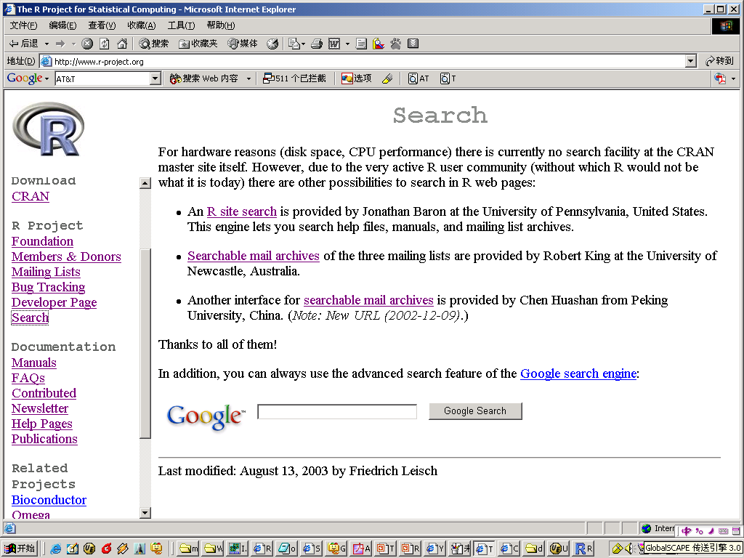
GETTING HELPS
SEVERAL COMMANDS
  HELP.START()
  HELP() OR ?()
  HELP.SEARCH()
  APROPOS()
INTERNET SEARCHING
  I LIKE IT VERY
  MUCH. IT SEEMS
  OMNIPOTENCE.

Slide 26
HOW TO SAVE /RESTORE / REMOVE OBJECTS?
THE COMMAND : > SINK() USED TO RESTORE THE OUTPUT FROM THE CONSOLE IN A FILE. THE FUNCTION SINK WILL DIVERT ALL SUBSEQUENT OUTPUT FROM THE CONSOLE TO AN EXTERNAL FILE, RECORD.LIS.
> SINK(“RECORD.LIS”)
EVERY R OBJECT CAN BE STORED INTO AND RESTORED FROM A FILE WITH THE COMMANDS “SAVE” AND “LOAD”.
  > SAVE(X, FILE=“X.RDATA”)
  > LOAD(“X.RDATA”)
TO REMOVE OBJECTS THE FUNCTION RM IS AVAILABLE
> RM(X, Y, Z, INK, JUNK, BAR)
THE COMMAND LINES USED IN THE SESSION ARE SAVED TO A FILE CALLED ‘.RHISTORY’.

Slide 27
REFERENCE BOOKS FOR R
SUDHA PUROHIT, “ R PROGRAMMING”
PIERRE-ANDRE CORNILLON AND JULIE JOSSE ETC “ R FOR STATISTICS” CRC PRESS
PETER DALGAARD (2002): INTRODUCTORY STATISTICS WITH R, SPRINGER.
BRAIN S EVERITT AND TORSTEN HOTHORN (2006): A HAND-BOOK OF STATISTICAL ANALYSES USING R, CHAPMAN AND HALL.
PAUL MURRELL (2006): R GRAPHICS, CHAPMAN AND HALL.
SIMON N WOOD (2006): GENERALIZED ADDITIVE MODELS- AN INTRODUCTION WITH R, CHAPMAN AND HALL.

Slide 28
REFERENCE BOOKS FOR R
JULIAN J FARAWAY (2004): LINEAR MODELS WITH R –CHAPMAN AND HALL.
DAVID SIEGMUND AND BENJAMIN YAKIR – THE STATISTICS OF GENE MAPPING, SPRINGER, 2007
JIM ALBERT – BAYESIAN COMPUTATION WITH R, SPRINGER, 2007
BRAIN EVERIIT – AN R AND S-FLUS COMPANION TO MULTIVARIATE ANALYSIS, SPRINGER, 2005
MICHAEL J CRAWLEY – THE R BOOK, WILEY, 2007

Slide 29
POINTS TO BE NOTED IN THE USAGE OF R
EVERYTHING IN R IS SOME KIND OF OBJECT.
OBJECTS CAN HAVE DIFFERENT MODES (NUMERIC, CHARACTER, LIST, FUNCTION, ETC.) WITH DIFFERENT STRUCTURES (SCALAR, VECTOR, MATRIX, ETC.) AND DIFFERENT CLASSES (DATA FRAME, LINEAR MODELS, ETC.).
ALMOST EVERY COMMAND YOU EXECUTE IN R USES ONE OR MORE FUNCTIONS.
FUNCTIONS ARE CALLED BY THEIR NAME FOLLOWED BY A SET OF PARENTHESES.
ARGUMENTS ARE PASSED TO THE FUNCTION, THEY ARE LISTED WITHIN THE PARENTHESES. THE PARENTHESES MUST ALWAYS BE PRESENT WHETHER OR NOT THERE ARE ANY ARGUMENTS.

Slide 30
Points to be noted in the usage of R
THE LIST OF ALL THE OBJECTS IN THE WORKING DIRECTORY, USE OBJECTS().
IF YOU WANT THE LIST OF OBJECTS IN ANOTHER DIRECTORY SPECIFY THE SEARCH PATH: OBJECTS(WHERE=3).
USE THE ASSIGNMENT OPERATOR TO CREATE OBJECTS. THE ASSIGNMENT OPERATOR IS THE "LESS THAN" SYMBOL FOLLOWED BY A HYPHEN ( <- ).
R IS CASE SENSITIVE. KEEP THAT IN MIND WHEN YOU'RE NAMING OBJECTS. WE COULD CREATE ANOTHER OBJECT CALLED TMP THAT WOULD BE SEPARATE AND DISTINCT FROM TMP.
THE ESCAPE KEY SERVES AS YOUR ABORT BUTTON. IF SOMETHING GOES WRONG OR YOU'RE SUDDENLY SEEING AN ENDLESS ARRAY OF NUMBERS SCROLLING BY, YOU CAN HIT THE ESCAPE KEY TO QUIT

Slide 31
POINTS TO BE NOTED IN THE USAGE OF R
YOU CAN RECALL PREVIOUS COMMANDS WITH THE UP-ARROW AND DOWN-ARROW KEYS. ONCE YOU'VE LOCATED THE COMMAND YOU WANT, YOU CAN HIT ENTER TO EXECUTE THE COMMAND AS IS, OR YOU CAN EDIT THE LINE FIRST. THIS CAN SAVE TIME, ESPECIALLY WITH COMPLICATED COMMANDS.
OPEN A GRAPHICS WINDOW WITH THE FUNCTION WIN.GRAPH().

Slide 32
BASIC OPERATORS USED IN R
ARITHMETIC OPERATIONS: + , - , * , / , ^ , %% , % / %
RELATIONAL OPERATOR: < , < = , > , > = , = = , ! =
LOGICAL OPERATOR: ! X , X & Y , X | Y , X && Y , X || Y , X OR (X,Y)
ASSIGNMENT OPERATOR : < -
MATRIX MULTIPLICATION: % * %
SPECIAL OPERATORS : $, [ , [ [ , ; , : , ?

Slide 33
R - USING AS CALCULATOR
> 2+2; OUTPUT : [1] 4 // ADDITION
> 2-2; OUTPUT : [1] 0 // SUBTRACTION
> 2*2; OUTPUT : [1] 4 // MULTIPLICATION
> 4/2; OUTPUT : [1] 2 // DIVISION
> 5%/% 2; OUTPUT : [1] 2 // INTEGER DIVISION
> 3^2; OUTPUT : [1] 9 // POWER
> 5%%3; OUTPUT : [1] 2 // MODULO
> 2+2^2; OUTPUT : [1] 6 //
> (2+2)^2; OUTPUT : [1] 16 //
> X = 5;
> Y = 10;
>Z <- X+Y;
> Z;
OUTPUT : [1] 15

Slide 34
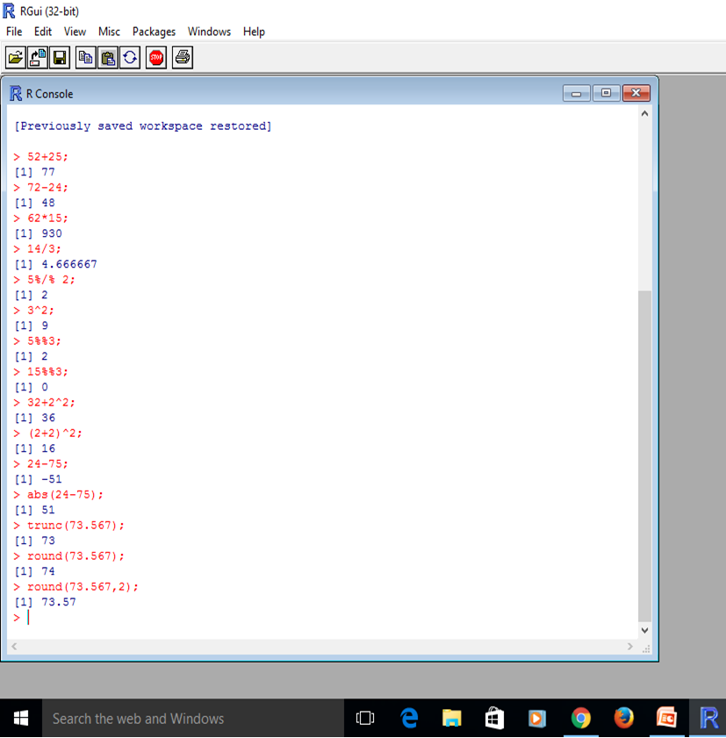
R CAN BE USED AS CALCULATOR
R CONSOLE CAN BE USED AS CALCULATOR FOR ARITHMETIC OPERATIONS.

Slide 35
MATHEMATICAL FUNCTIONS
ABS(X) : ABSOLUTE VALUE
CEILING(X) : SMALLEST FOLLOWING INTEGER
FLOOR(X) : LARGEST PREVIOUS INTEGER
TRUNC(X) : TRUNCATES THE VALUE OF TO 0 DIGITS
ROUND(X, DIGITS =N ) : ROUNDS TO N DECIMAL DIGITS
SQRT(X) : SQUARE ROOT
LOG(X) : LOGARITHM OF VALUE (NATURAL)
LOG10(X) : LOGARITHM OF VALUE (BASE 10)
EXP(X) : EXPONENTIAL 2.718282…
SIN(X), COS(X) , TAN(X) : TRIGONOMETRIC FUNCTIONS
ASIN(X), ACOS(X) , ATAN(X): INVERSE TRIGONOMETRIC FUNCTIONS
SINH(X),COSH(X),TANH(X):HYPERBOLIC TRIGONOMETRIC FUNCTIONS

Slide 36
MATHEMATICAL FUNCTIONS
> SQRT(2); OUTPUT : [1] 1.414214
> LOG(2); OUTPUT : [1] 0.6931472
> LOG10(2); OUTPUT : [1] 0.30103
> EXP(2); OUTPUT : [1] 7.389056
> SIN(30*PI/180); OUTPUT : [1] 0.5
> COS(30*PI/180); OUTPUT : [1] 0.8660254
> TAN(45*PI/180); OUTPUT : [1] 1
> SQRT(-17+0I) OUTPUT: [1] : 0+4.123106I
*NOTE: SQRT(-17) WILL GIVE A WARNING, BUT SQRT(-17+0I) WILL DO THE COMPUTATIONS AS COMPLEX NUMBERS.
Arcsine | sin⁻¹(-x) = -sin⁻¹(x), x ∈ [-1, 1]
Arccosine | cos⁻¹(-x) = π -cos⁻¹(x), x ∈ [-1, 1]
Arctangent | tan⁻¹(-x) = -tan⁻¹(x), x ∈ R

Slide 37
SIMPLE DATA HANDLING FUNCTIONS
SORT(X) : TO SORT IN ASCENDING ORDER
SORT(X, DECREASING=TRUE): TO SORT IN DESCENDING ORDER
MAX(X) : TO SELECT THE LARGEST ELEMENT OF A VECTOR
MIN(X) : TO SELECT THE SMALLEST ELEMENT OF A VECTOR
LENGTH(X) : TO FIND THE NUMBER OF ELEMENTS IN X,
SUM(X) : TO FIND THE TOTAL OF THE ELEMENTS IN X,
PROD(X) : TO FIND THE PRODUCT OF ELEMENTS IN THE VECTOR.
DIM(X) : DIMENSION OF AN OBJECT X
WHICH.MAX(X): INDEX OF THE MAXIMUM OF A VECTOR
WHICH.MIN(): INDEX OF THE MINIMUM OF A VECTOR
AS.LIST(X): CONVERTS X INTO A LIST

Slide 38
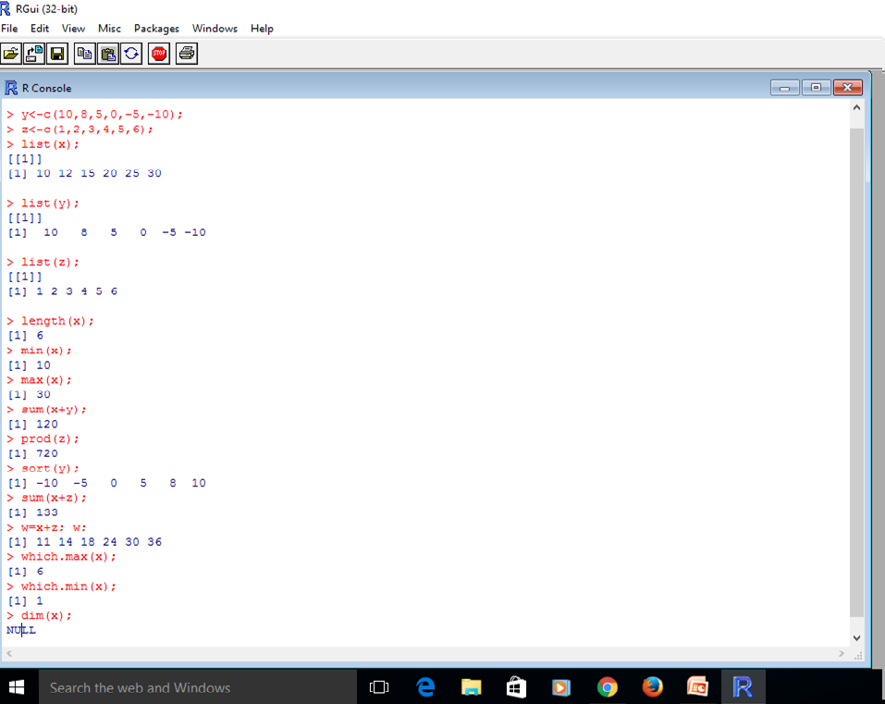
R CODE
> MAX(V3); MIN(V3)
[1] 16
[1] 6
> LENGTH(V3)
[1] 6
> MEAN(V3)
[1] 11
> SD(V3)
[1] 3.741657

Slide 39
DATA TYPES USED IN R
  IN PROGRAMMING, THE VARIABLES ARE ASSIGNED WITH R-OBJECTS AND NEED TO STORE VARIOUS INFORMATION IN AND THE DATA TYPE OF THE R-OBJECT BECOMES THE DATA TYPE OF THE VARIABLE. FREQUENTLY USED DATA TYPES IN R-PROGRAMMING ARE
  VECTORS
  LISTS
  ARRAY
  FACTORS
  DATA FRAMES
Notes:
Example graph/chart.

Slide 40
VECTOR OF DATA OBJECT
THE BASIC DATA OBJECT IS A VECTOR OF ELEMENTS OF TYPE:
  NUMERIC NUMBERS (EITHER FLOATING POINT OR INTEGERS)
  CHARACTER EACH ELEMENT IS A CHARACTER STRING
  LOGICAL EACH ELEMENT IS TRUE OR FALSE
  LIST ELEMENTS CAN BE ANY TYPE OF OBJECT, INCLUDING OTHER LISTS
ANY VECTOR CAN INCLUDE THE MISSING DATA MARKER NA AS AN ELEMENT.
THE FUNCTION LENGTH RETURN THE INFORMATION ABOUT THE SIZE OF THE VECTOR.
THE FUNCTION MODE RETURN THE INFORMATION ABOUT THE DATA TYPE OF THE COMPONENTS OF VECTOR.

Slide 41
1. CREATION OF A VECTOR WITH ‘C’ FUNCTION’
CREATE A VECTOR NAMED X WITH ELEMENTS 10.4, 5.6, 3.1, 6.4, 21.7, IN R AT COMMAND PROMPT. > X <- C(10.4, 5.6, 3.1, 6.4, 21.7) OR > C(10.4, 5.6, 3.1, 6.4, 21.7) -> X OR
> ASSIGN("X", C(10.4, 5.6, 3.1, 6.4, 21.7))
CONCATENATION OF THE VECTOR X IS: (10.4, 5.6, 3.1, 6.4, 21.7)
LENGTH(X): RESULTS TO THE NUMBER OF ELEMENTS IN X
MODE(X) : RESULTS TO DATA TYPE I.E NUMERIC OR CHARACTER
  FRUITS=C(“APPLE”, “BANANA”, “GRAPES”, “PAPAYA”)
  FRUITS
  PRINT(CLASS(FRUITS)) # TO GET THE CLASS OF THE VECTOR
OUTPUT OF THE ABOVE PROGRAM WOULD BE
  [1] “APPLE” “BANANA” “GRAPES” “PAPAYA”
  [2] CHARACTER

Slide 42
ADDITION , MULTIPLICATION AND DIVISION OF OF TWO VECTORS:
> V1 = C(6,5,4,3,2,1);
> V2 = C(10,9,8,7,6,5);
> V3 = V1 + V2;
> V4 = V1 - V2;
> V5 = V1 * V2;
> V6 = V1 / V2;
> V1; V2; V3; V4; V5; V6;
OUTPUT:
[1] 6 5 4 3 2 1
[1] 10 9 8 7 6 5
[1] 16 14 12 10 8 6
[1] -4 -4 -4 -4 -4 -4
[1] 60 45 32 21 12 5
[1] 0.6000000 0.5555556 0.5000000 0.4285714 0.3333333 0.2000000

Slide 43
OPERATIONS ON VECTORS
FIND THE RECIPROCALS OF THE ELEMENTS IN THE VECTOR X:
> X <- C(10,12,15,20,25,30);
> U<-1/X;
> U;
[1] 0.1000000 0.0833333 0.0666667 0.0500000 0.0400000 0.0333333
ADDING TWO UNEQUAL LENGTH VECTORS
> X <- C(10,12,15,20,25,30);
> Z <- C(1, 2, 3, 4, 5 );
> W=X+Z; W;
WARNING MESSAGE:
IN X + Z : LONGER OBJECT LENGTH IS NOT A MULTIPLE OF SHORTER OBJECT LENGTH
[1] 11 14 18 24 30 31

Slide 44
OPERATIONS ON VECTORS
> C("X","Y")[REP(C(1,2,2,1), TIMES=4)]
IT PRODUCES A CHARACTER VECTOR OF LENGTH 16 CONSISTING OF "X", "Y", "Y", "X" REPEATED FOUR TIMES.
> P<-C(1:10)
IT SELECTS THE FIRST 10 ELEMENTS ARE SELECTED FOR AN INDEX VECTOR X AND CONCATENATED.
> Y <- P[-(1:5)]
THE INDEX VECTOR Y SPECIFIES THE VALUES TO BE EXCLUDED 1TO 5 RATHER THAN INCLUDED .

Slide 45
LOGICAL OPERATIONS ON VECTORS
THE LOGICAL OPERATORS USED IN R ARE <, <=, >, >=, == , != .
LOGICAL VECTOR CONTAINING TRUE OR FALSE OR NA CAN BE GENERATED BY CONDITIONS.
CREATE A VECTOR TEMP BY SETTING THE SAME LENGTH AS X WITH VALUES, FALSE (F) CORRESPONDING TO ELEMENTS OF X WHEN THE CONDITION IS NOT SATISFIED AND TRUE WHEN IT IS SATISFIED.
> X<-C(21,25,10,9,5,28);
> TEMP<- X > 13;
> TEMP;
[1] TRUE TRUE FALSE FALSE FALSE TRUE
IF C1 AND C2 ARE LOGICAL EXPRESSIONS, THEN C1 & C2 IS THEIR INTERSECTION (“AND”), C1 | C2 IS THEIR UNION (“OR”), AND !C1 IS THE NEGATION OF C1.

Slide 46
CONCATENATION OF TWO STRINGS
CHARACTER VECTORS MAY BE CONCATENATED INTO A VECTOR BY THE C() FUNCTION; EXAMPLES OF THEIR USE WILL EMERGE FREQUENTLY. THE PASTE() FUNCTION TAKES AN ARBITRARY NUMBER OF ARGUMENTS AND CONCATENATES THEM ONE BY ONE INTO CHARACTER STRINGS. ANY NUMBERS GIVEN AMONG THE ARGUMENTS ARE COERCED INTO CHARACTER STRINGS IN THE EVIDENT WAY, THAT IS, IN THE SAME WAY THEY WOULD BE IF THEY WERE PRINTED. THE ARGUMENTS ARE BY DEFAULT SEPARATED IN THE RESULT BY A SINGLE BLANK CHARACTER, BUT THIS CAN BE CHANGED BY THE NAMED PARAMETER, SEP=STRING, WHICH CHANGES IT TO STRING, POSSIBLY EMPTY.
EXAMPLE: TO CREATE A CHARACTER VECTOR NAMED ‘LABS’ CONTAINING CONCATENATED STRINGS: "X1", "Y2", "X3", "Y4", "X5", "Y6", "X7", "Y8", "X9", "Y10". NOTE PARTICULARLY THAT RECYCLING OF SHORT LISTS TAKES PLACE HERE TOO; THUS C("X", "Y") IS REPEATED 5 TIMES TO MATCH THE SEQUENCE 1:10. USE AT COMMAND PROMPT:
> LABS <- PASTE(C("X","Y"), 1:10, SEP="")
[1] "X1" "Y2" "X3" "Y4" "X5" "Y6" "X7" "Y8" "X9" "Y10"

Slide 47
2. Creation of a Vector with ‘scan’ function’
CREATE A VECTOR NAMED X WITH ELEMENTS 10.4, 5.6, 3.1, 6.4, 21.7, IN R AT COMMAND PROMPT.
> X <- SCAN(); (PRESS ENTER KEY)
1: 10.4 5.6 3.1 6.4 21.7 (PRESS ENTER KEY)
5: (PRESS ENTER KEY)
NOTE: ENTER DATA ELEMENT AND WITH SPACE BAR BETWEEN THE ELEMENTS AT THE END OF ENTERING PRESS ENTER KEY TWICE.
THE RESULTING VECTOR X IS (10.4, 5.6, 3.1, 6.4, 21.7)

Slide 48
3. Creation of Vector with ‘c and rep’ function
A FUNCTION REP() CAN BE USED FOR REPLICATING AN OBJECT IN VARIOUS COMPLICATED WAYS.
CREATE A VECTOR NAMED X WITH ELEMENTS 10, 5, 6, 3, 1, 10, 5, 6, 5, 1, 10, 6, 3, 10 IN R AT COMMAND PROMPT.
>X<-C(REP(10,4), REP(5,3), REP(6, 3), REP(3,2) REP(1,2)); X;
OUTPUT: 10, 10, 10, 10, 5, 5, 5, 6, 6, 6, 3, 3, 1, 1,
TO REPEATS EACH ELEMENT OF X FIVE TIMES
> X<- C(2,5,8,9);
> Y<- REP(X, TIME=5);
> Z<- REP(X, EACH=5);
> Y; Z;
OUTPUT: [1] 2 5 8 9 2 5 8 9 2 5 8 9 2 5 8 9 2 5 8 9
[1] 2 2 2 2 5 5 5 5 5 8 8 8 8 8 9 9 9 9 9

Slide 49
GENERATION OF SEQUENCE OF VALUES
TO GENERATE THE SEQUENCE OF VALUES RANGING FROM 1 TO 5 WITH A STEP OF INCREMENT 0.5 CAN BE AS:
> SEQ(1, 5, BY = 0.5);
OUTPUT: [1] 1.0 1.5 2.0 2.5 3.0 3.5 4.0 4.5 5.0
GENERATE A SEQUENCE VECTOR OF ELEMENTS -5.0, -4.8, -4.6, ..., 4.6, 4.8, 5.0 USING SEQ() FUNCTION:
> S3<- SEQ(-5, 5, BY=0.2) OR
> S4<- SEQ(LENGTH=51, FROM=-5, BY=.2)
TO LIST THE ELEMENTS 1 TO 5
> LIST(1:5); OUTPUT: [[1]] [1] 1 2 3 4 5
> LIST(2,3,5); OUTPUT: [[1]] [1] 2 [[2]] [1] 3 [[3]] [1] 5

Slide 50
GENERATION OF SEQUENCE OF VALUES
THE COLON OPERATOR HAS HIGH PRIORITY WITHIN AN EXPRESSION.
GENERATE A VECTOR WITH ELEMENTS 1 TO 30:
X<- C(1:30) IS THE VECTOR C(1, 2,3, 4, ..., 29, 30).
X<- C(2*1:15) IS THE VECTOR C(2, 4, ..., 28, 30).
THE CONSTRUCTION 30:1 MAY BE USED TO GENERATE A SEQUENCE BACKWARDS.

Slide 51
LISTS
An ordered collection of data of arbitrary types is called a list. A list can be created by their names (a character string).
> doe = list(name="john",age=28,married=F)
> doe$name
[1] "john“
> doe$age
[1] 28
Typically, vector elements are accessed by their index (an integer), list elements by their name (a character string). But both types support both access methods.

Slide 52
OPERATIONS ON MATRICES
THE GENERAL OPERATIONS APPLIED ON THE MATRICES ARE:
TRANSPOSE OF A MATRIX.
ADDITION OF TWO MATRICES.
SUBTRACTION OF ONE FROM ANOTHER MATRIX.
PRODUCT OF TWO MATRICES.
DETERMINANT OF A SQUARE MATRIX.
INVERSE OF A MATRIX (GENERALIZED INVERSE).
EIGEN VALUES AND EIGEN VECTORS.

Slide 53
MASS PACKAGE
THE OPERATIONS ON MATRICES CAN BE APPLIED IN R BY USING THE PACKAGES:
MASS PACKAGE

Slide 54
READING AND DISPLAYING MATRICES
> A = MATRIX (C(4,5,6,7,8,9,5,4,6),3,3); A;
[,1] [,2] [,3]
[1,] 4 7 5
[2,] 5 8 4
[3,] 6 9 6
> B=MATRIX(C(5,8,6,4,2,1,8,6,9),3,3,); B;
[,1] [,2] [,3]
[1,] 5 4 8
[2,] 8 2 6
[3,] 6 1 9

Slide 55
TRANSPOSE OF MATRIX
> A = MATRIX (C(4,5,6,7,8,9,5,4,6),3,3); A;
[,1] [,2] [,3]
[1,] 4 7 5
[2,] 5 8 4
[3,] 6 9 6
> T(A); // TRANSPOSE OF MATRIX A
[,1] [,2] [,3]
[1,] 4 5 6
[2,] 7 8 9
[3,] 5 4 6
> A+B; // ADDITION OF MATRICES
[,1] [,2] [,3]
[1,] 9 11 13
[2,] 13 10 10
[3,] 12 10 15

Slide 56
ADDITION OF TWO MATRICES
> A = MATRIX (C(4,5,6,7,8,9,5,4,6),3,3); A;
[,1] [,2] [,3]
[1,] 4 7 5
[2,] 5 8 4
[3,] 6 9 6
> B=MATRIX(C(5,8,6,4,2,1,8,6,9),3,3,); B;
[,1] [,2] [,3]
[1,] 5 4 8
[2,] 8 2 6
[3,] 6 1 9
> A+B; // ADDITION OF TWO MATRICES A AND B
[,1] [,2] [,3]
[1,] 9 11 13
[2,] 13 10 10
[3,] 12 10 15

Slide 57
SUBTRACTION OF TWO MATRICES
> A = MATRIX (C(4,5,6,7,8,9,5,4,6),3,3); A;
[,1] [,2] [,3]
[1,] 4 7 5
[2,] 5 8 4
[3,] 6 9 6
> B=MATRIX(C(5,8,6,4,2,1,8,6,9),3,3,); B;
[,1] [,2] [,3]
[1,] 5 4 8
[2,] 8 2 6
[3,] 6 1 9
A-B; // SUBTRACTION OF B FROM A
[,1] [,2] [,3]
[1,] -1 3 -3
[2,] -3 6 -2
[3,] 0 8 -3

Slide 58
PRODUCT OF TWO MATRICES
> A = MATRIX (C(4,5,6,7,8,9,5,4,6),3,3); A;
[,1] [,2] [,3]
[1,] 4 7 5
[2,] 5 8 4
[3,] 6 9 6
> B=MATRIX(C(5,8,6,4,2,1,8,6,9),3,3,); B;
[,1] [,2] [,3]
[1,] 5 4 8
[2,] 8 2 6
[3,] 6 1 9
> A %*% B; // MULTIPLICATION OF TWO MATRICES
[,1] [,2] [,3]
[1,] 106 35 119
[2,] 113 40 124
[3,] 138 48 156

Slide 59
INVERSE OF A MATRIX
> A = MATRIX (C(4,5,6,7,8,9,5,4,6),3,3); A;
[,1] [,2] [,3]
[1,] 4 7 5
[2,] 5 8 4
[3,] 6 9 6
> INV=GINV(A); INV; // INVERSE OF MATRIX A
[,1] [,2] [,3]
[1,] -1.3333333 -0.3333333 1.3333333
[2,] 0.6666667 0.6666667 -1.0000000
[3,] 0.3333333 -0.6666667 0.3333333

Slide 60
EIGEN VALUES
EIGEN() DECOMPOSITION
$VALUES:
[1] 17.8030943 0.8162432 -0.6193376
$VECTORS:
[,1] [,2] [,3]
[1,] -0.5142587 0.4172168 -0.8809884
[2,] -0.5356055 -0.6462044 0.3806384
[3,] -0.6698245 0.6390227 0.2810228

Slide 61
R- CONTROL FLOW STRUCTURES
IF (CONDITION) EXPR
IF (CONDITION) CONS.EXPR ELSE ALT.EXPR
FOR(VAR IN SEQ) EXPR
WHILE(CONDITION) EXPR
REPEAT EXPR
BREAK
NEXT

Slide 62
CONTROL STRUCTURES
    CONDITIONAL STATEMENT: IF-ELSE SYNTAX:
    IF (CONDITION) STATEMENTS
    IF (CONDITION) STATEMENTS SET1 ELSE STATEMENTS SET2
    IF-ELSE(TEST, YES, NO)
    CONTROL FLOW STATEMENT :
    FOR LOOP : FOR (VAR IN SEQ) EXPR
    WHILE LOOP : WHILE (CONDITION) EXPR
    SWITCH CASE : SWITCH (EXPR, ...)
    REPEAT UNTIL : REPEAT ( EXPR …)
NOTE: THE BREAK AND NEXT COMMANDS ALLOW THE FLOW OF A LOOP TO BE ALTERED
  BREAK JUMPS OUT THE LOOP
  NEXT JUMPS TO THE NEXT ITERATION OF THE LOOP

Slide 63
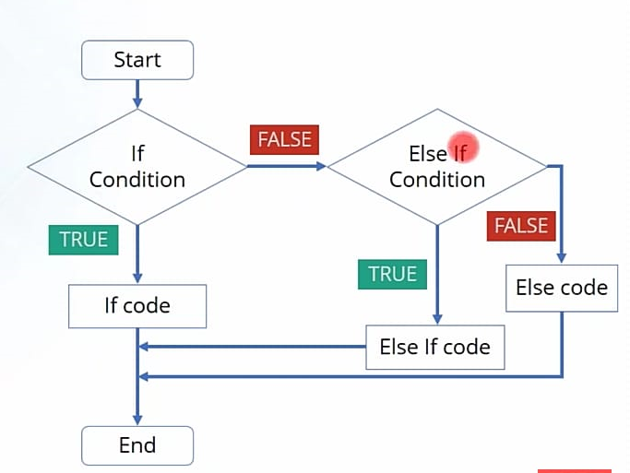
CONTROL STATEMENT: IF…ELSE…
Syntax:
if (condition)
{
Statement
Statement
…
Statement
}
else
{
Statement Statement
…
Statement
}

Slide 64
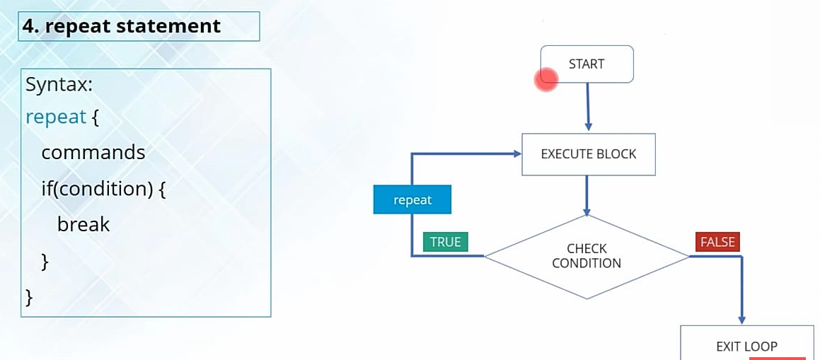
REPEAT STATEMENT

Slide 65
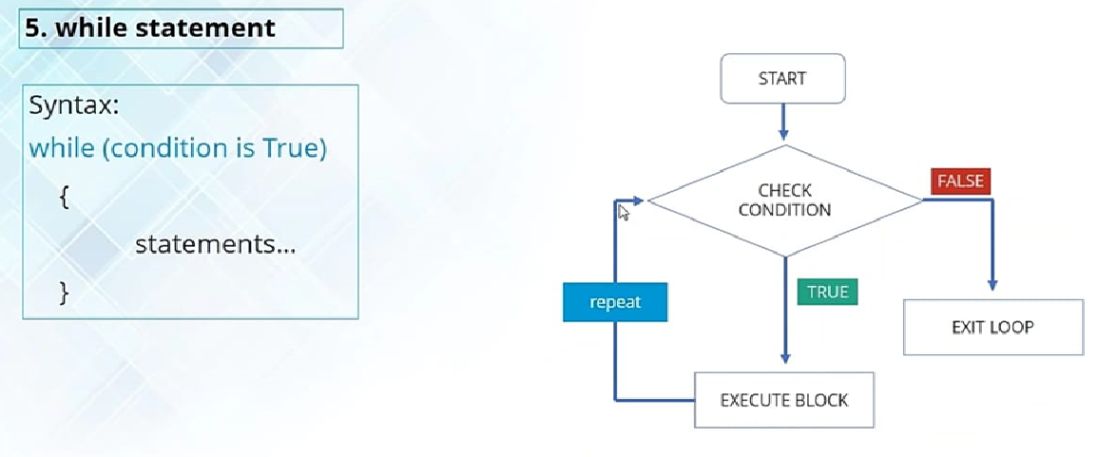
WHILE STATEMENT

Slide 66
FOR LOOP
  FOR (I IN 1:N)
  {
    STATEMENT-1;
    STATEMENT-2;
    … … …
    STATEMENT-N;
    }
    THE DIFFERENT WAYS OF USAGE OF FOR LOOP IS:
    FOR(I IN (1:10)*4)
    FOR(J IN C(3,1,4,1,5,9,2,7))
    FOR(VARIABLE IN NAMES(DATA)
    FOR(F IN C(SIN, COS, TAN))

Slide 67
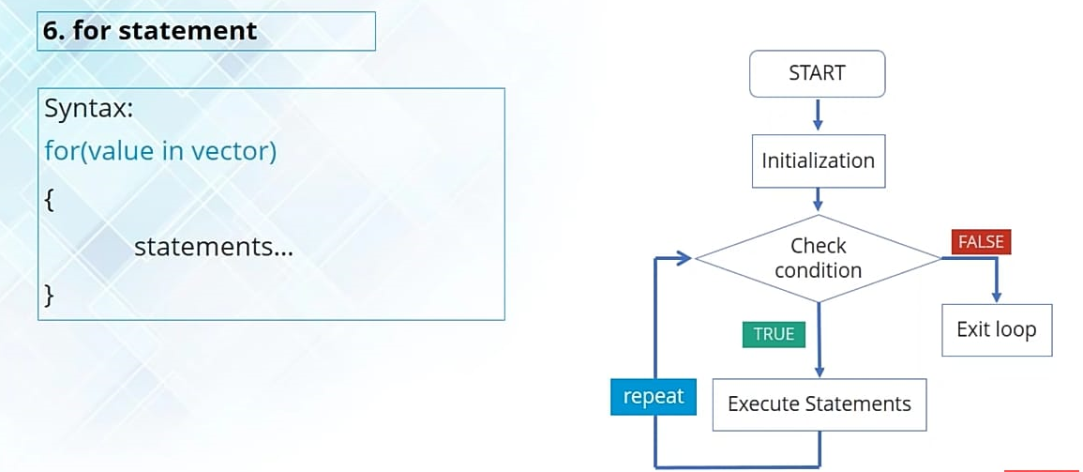
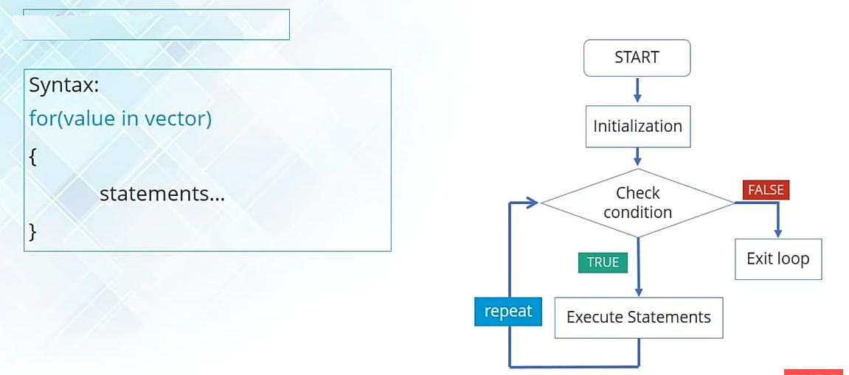

Slide 68
AVOIDING ITERATION
THE CANONICAL BAD R PROGRAM :
    FOR(I IN 1:N) {
  D[I] <- A[I] * B[I] ## MULTIPLY TWO VECTORS
    }
    S <- 0
    FOR (I IN 1:N) {
    S <- S + D[I] ##COMPUTE THE INNER PRODUCT
    }
THE RIGHT WAY TO DO THIS IS
  S<-SUM(A*B)
APPLY(); LAPPLY(); SAPPLY()

Slide 69
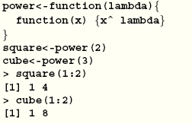
WRITE R FUNCTION
A FUNCTION DEFINITION LOOKS LIKE
MEDIAN <- FUNCTION(X, NA.RM = FALSE)
{
…LOTS OF CODE...
## A RETURN VALUE
}

Slide 70
FUNCTION CREATIONS
THE FUNCTION EXPRESSION IS A GROUPED EXPRESSION, THAT USES THE ARGUMENTS, ARG I, TO CALCULATE A VALUE.
THE VALUE OF THE EXPRESSION IS THE VALUE RETURNED FOR THE FUNCTION.
A CALL TO THE FUNCTION THEN USUALLY TAKES THE FORM NAME(EXPR_1, EXPR_2, ...) AND MAY OCCUR ANYWHERE A FUNCTION CALL IS LEGITIMATE.
THE SYNTAX FOR CREATION OF A FUNCTION IS :
> NAME <- FUNCTION(ARG_1, ARG_2, ...) EXPRESSION

Slide 71
EXAMPLE
A FUNCTION WITH NAME TWOSAM CAN BE CREATED LIKE AS FOLLOWS:
> TWOSAM <- FUNCTION(Y1, Y2) {
N1 <- LENGTH(Y1); N2 <- LENGTH(Y2)
YB1 <- MEAN(Y1); YB2 <- MEAN(Y2)
S1 <- VAR(Y1); S2 <- VAR(Y2)
S <- ((N1-1)*S1 + (N2-1)*S2)/(N1+N2-2)
TST <- (YB1 - YB2)/SQRT(S*(1/N1 + 1/N2))
TST
}
> TSTAT <- TWOSAM(DATA$MALE, DATA$FEMALE); TSTAT
// CALLING THE FUNCTION FOR THE DATA MALE & FEMALE

Slide 72
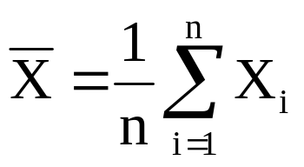
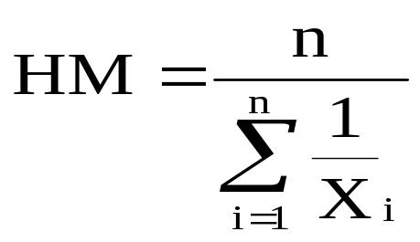
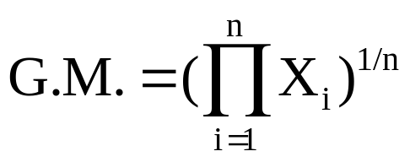
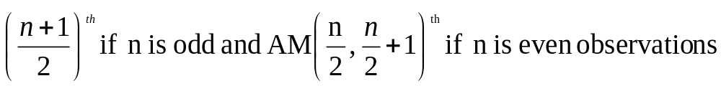
MEASURES OF CENTRAL TENDENCIES
ARITHMETIC MEAN:
HARMONIC MEAN:
GEOMETRIC MEAN:
MEDIAN:
MODE: MAXIMUM FREQUENCY OBSERVATION

Slide 73
MEASURES OF CENTRAL TENDENCIES
>X<-C(136, 112, 103, 123, 143, 134, 115, 106, 122, 142, 133, 120, 108, 121, 145, 126, 120, 104, 120, 144, 124, 136, 105, 130, 144, 117, 134, 132, 120, 110, 110, 133, 128, 130, 115, 110, 141, 126, 140, 120, 120, 148, 124, 142, 130, 135, 152, 108, 138, 150);
> PRINT(" NO. OF OBSERVATIONS = "); LENGTH(X);
[1] " NO. OF OBSERVATIONS = "
[1] 50
> PRINT(" MEAN = "); MEAN(X);
[1] " MEAN = "
[1] 126.58
> PRINT(" MEDIAN = "); MEDIAN(X);
[1] " MEDIAN = "
[1] 126

Slide 74
MEASURES OF CENTRAL TENDENCIES
> PRINT(" MODE = "); WHICH.MAX(TABLE(X));
[1] " MODE = “
120
10
> R<-1/X;
> PRINT("HARM0NIC MEAN = "); 1/MEAN(R);
[1] "HARMONIC MEAN = “
[1] 1.003968E-105
Y<-PROD(X);
N<-LENGTH(X);
> PRINT(" GEOMETRIC MEAN =");(Y^(1/N));
[1] " GEOMETRIC MEAN ="
[1] 125.8826

Slide 75
CONSTRUCTION OF FREQUENCY DISTRIBUTION TABLE FOR RAW DATA
> PRINT(" FREQUENCY DISTRIBUTION TABLE FOR THE DATA IS: "); TABLE(X);
[1] " FREQUENCY DISTRIBUTION TABLE FOR THE DATA IS:″ X
103 104 105 106 108 110 112 115 117 120 121 122 123 124 126 128 130 132 133 134
1 1 1 1 2 3 1 2 1 6 1 1 1 2 2 1 3 1 2 2
135 136 138 140 141 142 143 144 145 148 150 152
1 2 1 1 1 2 1 2 1 1 1 1

Slide 76
VARIANCE FOR GROUPED DATA
L<-C(145,150,155,160,165,170,175);
U<-C(150,155,160,165,170,175,180);
F<-C(15,23,28,39,30,25,14);
X<-1/2*(L+U); PRINT(X);X;
FX<-F*X; PRINT("FX=");FX;
X2<-X*X; PRINT("X2=");X2;
FX2<-F*X2; PRINT("FX2=");FX2;
MEAN<-SUM(FX)/SUM(F); PRINT("MEAN=");MEAN;
VARIANCE<-(SUM(FX2)/SUM(FX))-(MEAN*MEAN);
SD=SQRT(VARIANCE);
PRINT("VARIANCE=");VARIANCE;
PRINT(“STANDARD DEVIATION=");SD;

Slide 77
CONSIDER THE FOLLOWING FREQUENCY DISTRIBUTION AND EVALUATE VARIOUS CENTRAL TENDENCIES AND DISPERSIONS MOMENT SKEWNESS AND KURTOSIS VALUES .
Class Interval | 0 – 10 | 10 – 20 | 20 – 30 | 30 – 40 | 40 – 50 | 50 – 60 | 60 – 70 | 70 – 80
Frequency | 18 | 26 | 46 | 59 | 45 | 35 | 25 | 15

Slide 78
COMPUTATION OF DISPERSION
RANGE
QUARTILE DEVIATION
MEAN DEVIATION
STANDARD DEVIATION
VARIANCE
COEFFICIENT OF VARIATION.

Slide 79
MOMENTS
COMPUTE (I) FIRST FOUR NON CENTRAL MOMENTS ABOUT A= 0, 5 AND 10 (II) FIRST FOUR CENTRAL MOMENTS

Slide 80
COMPUTE (I) FIRST FOUR NON CENTRAL MOMENTS ABOUT A= 0, 5 AND 10 (II) FIRST FOUR CENTRAL MOMENTS

Slide 81
R PROGRAM FOR EVALUATION OF BASIC STATISTICS.
> X<-C(136,112,103,123,143,134,115,106,122,142,133,120,108,121,145,126,120, 104,120,144,124,136,105,130,144,117,134,132,120,110,110,133,128,130,115, 110,141,126,140,120,120,148,124,142,130,135,152,108,138,150);
N<-LENGTH(X);
R<-1/X;
Z<-PROD(X);
PRINT("NO. OF OBSERVATIONS=");LENGTH(X);
PRINT("THE SAMPLE OBSERVATIONS ARE:")
X;
PRINT("MINIMUM OBSERVATION")MIN(X);
PRINT("MAXIMUM OBSERVATION")MAX(X);
PRINT("SUM OF THE OBSERVATIONS : ") MAX(X);
PRINT(" MEAN = "); MEAN(X);
PRINT(" MEDIAN = "); MEDIAN(X);
PRINT(" MODE = "); WHICH.MAX(TABLE(X));
PRINT("HARMANIC MEAN = "); 1/MEAN(Y);
PRINT(" GEOMETRIC MEAN =");(Z^(1/N));
PRINT(" RANGE ="); RANGE(X);
PRINT(" QUARTILE DEVIATION ="); IQR(X);
PRINT("VARIANCE ="); VAR(X);
PRINT( "STANDARD DEVIATION ="); SD(X);
PRINT(" FREQUECY DISTRIBUTION TABLE FOR THE DATA IS: ");TABLE(X);

Slide 82
# R PROGRAM FOR EVALUATION OF CORRELATION
X<-C(136,112,103,123,143,134,115,106,122,142,133,120,108,121,145)
Y<-C(126,120,104,120,144,124,136,105,130,144,117,134,132,120,110)
Z<-C(110,133,128,130,115,110,141,126,140,120,120,148,124,142,130)
N<-LENGTH(X);
PRINT("NO. OF OBSERVATIONS=");LENGTH(X);
PRINT("THE SAMPLE OBSERVATIONS ARE:")
PRINT(" MEAN OF X= "); MEAN(X);
PRINT(" MEAN OF Y= "); MEAN(Y);
PRINT(" MEAN OF Z= "); MEAN(Z);
PRINT("VARIANCE OF X="); VAR(X);
PRINT("VARIANCE OF Y="); VAR(Y);
PRINT("VARIANCE OF Z="); VAR(Z);
PRINT( "STANDARD DEVIATION OF X="); SD(X);
PRINT( "STANDARD DEVIATION OF Y="); SD(Y);
PRINT( "STANDARD DEVIATION OF Z="); SD(Z);
RXY<-COR(X,Y,"PEARSON")
RXZ<-COR(X,Z,"PEARSON")
RYZ<-COR(Y,Z,"PEARSON")
PRINT(" CORRELATIONS BETWEEN (X,Y); (Y,Z) AND (Z,X) ARE") RXY; RYZ; RZX;

Slide 83
# R PROGRAM FOR MATRIX OPERATIONS: ADDITION, SUBTRACTION, TRANSPOSE, MULTIPLICATION AND INVERSE, (USE PACKAGE MATRIX)
X=MATRIX(C(4,5,6,7,8,9,5,4,6),3,3);
Y=MATRIX(C(5,8,6,4,2,1,8,6,9),3,3,);
PRINT("THE MATRIX X IS")
X;
PRINT("THE MATRIX Y IS")
Y;
PRINT("TRANSPOSE OF MATRIX X IS")
T(X);
PRINT("ADDITION OF THE TWO MATRICES ISX AND Y IS")
X+Y;
PRINT("SUBTRACTION OF MATRIX Y FROM ANOTHER MATRIX X IS")
X-Y;
PRINT("PRODUCT OF THE TWO MATRICES ISX AND Y IS")
X%*%Y;
PRINT("INVERSE OF A MATRIX X IS")
GINV(X);

Slide 84
# COMPUTATION OF MEAN AND VARIANCE FOR GIVEN FREQUENCY DISTRIBUTION
LL<-C(145,150,155,160,165,170,175);
UL<-C(150,155,160,165,170,175,180);
FREQ<-C(15,23,30,39,30,23,15);
N<-SUM(FREQ)
X<-1/2*(LL+UL);
FX<-FREQ*X;
X2<-X*X;
FX2<-FREQ*X2;
MEAN<-SUM(FX)/SUM(FREQ);
VARIANCE<-(SUM(FX2)/N)-(MEAN*MEAN);
PRINT(X);X;
PRINT("FX=");FX;
PRINT("X2=");X2;
PRINT("FX2=");FX2;
PRINT("MEAN=");MEAN;
PRINT("VARIANCE=");VARIANCE;

Slide 85
IMPORTING DATA
IMPORTING DATA FROM
.XLS FILE
.CSV FILE
.TXT FILE
.XML FILE
.SAV FILE (SPSS)
.XPT FILE (SAS)
.STA FILE (STAT)
.SYS FILE (SYSTAT) …

Slide 86
DATA INTERFACES - CSV
In R, we can read data from files stored outside the R environment. We can also write data into files which will be stored and accessed by the operating system. R can read and write into various file formats like csv, excel, xml etc.
Getting and Setting the Working Directory
  getwd() is used to check to your current directory
  setwd() is used to set to a new working directory.
    >print(getwd()) # Get & print current working directory
    >setwd("/web/com") # Set current working directory.
    >print(getwd()) # Get & print current working directory

Slide 87
INPUT .CSV FILE
The csv file is a text file in which the values in the columns are separated by a comma. Let's consider the following data present in the file named input.csv
    id,name,salary,start_date,dept
    1,Rick,623.3,2012-01-01,IT
    2,Dan,515.2,2013-09-23,Operations
    3,Michelle,611,2014-11-15,IT
    4,Ryan,729,2014-05-11,HR
    5,Gary,843.25,2015-03-27,Finance
    6,Nina,578,2013-05-21,IT
    7,Simon,632.8,2013-07-30,Operations
    8,Guru,722.5,2014-06-17,Finance

Slide 88
READ .CSV FILE
  data <- read.csv("input.csv")
  print(data)
    id, name, salary, start_date, dept
    1 1 Rick 623.30 2012-01-01 IT
    2 2 Dan 515.20 2013-09-23 Operations
    3 3 Michelle 611.00 2014-11-15 IT
    4 4 Ryan 729.00 2014-05-11 HR
    5 NA Gary 843.25 2015-03-27 Finance
    6 6 Nina 578.00 2013-05-21 IT
    7 7 Simon 632.80 2013-07-30 Operations
    8 8 Guru 722.50 2014-06-17 Finance

